Slide 1
GAN(Generative Adversarial Nets)
CUAI 박정재 양명철

Slide 2
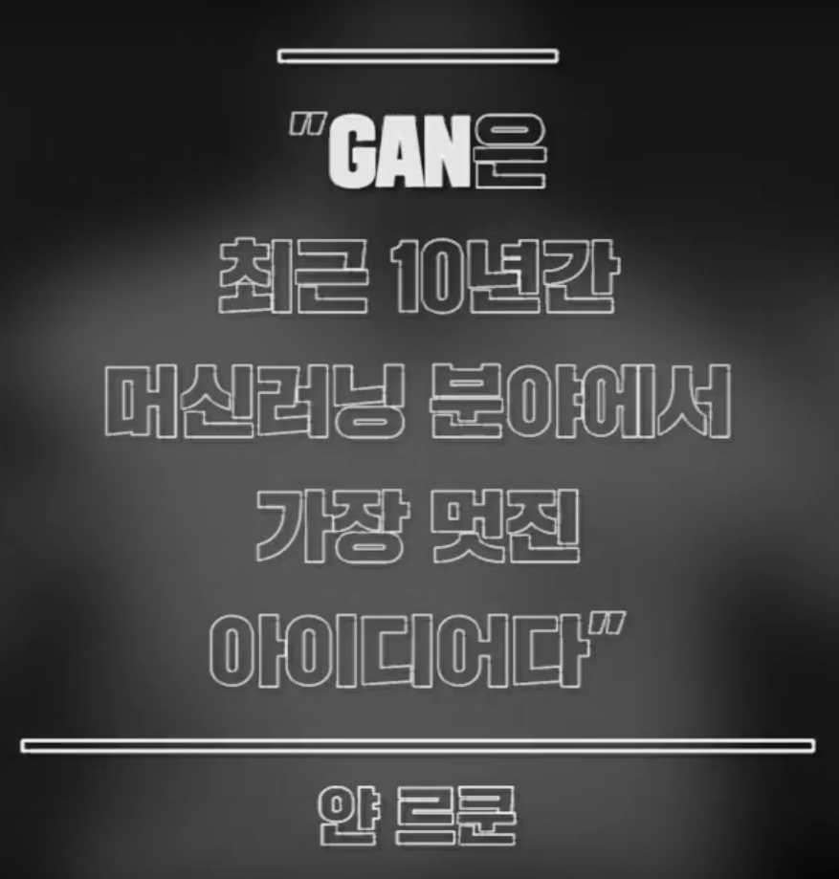

Slide 3
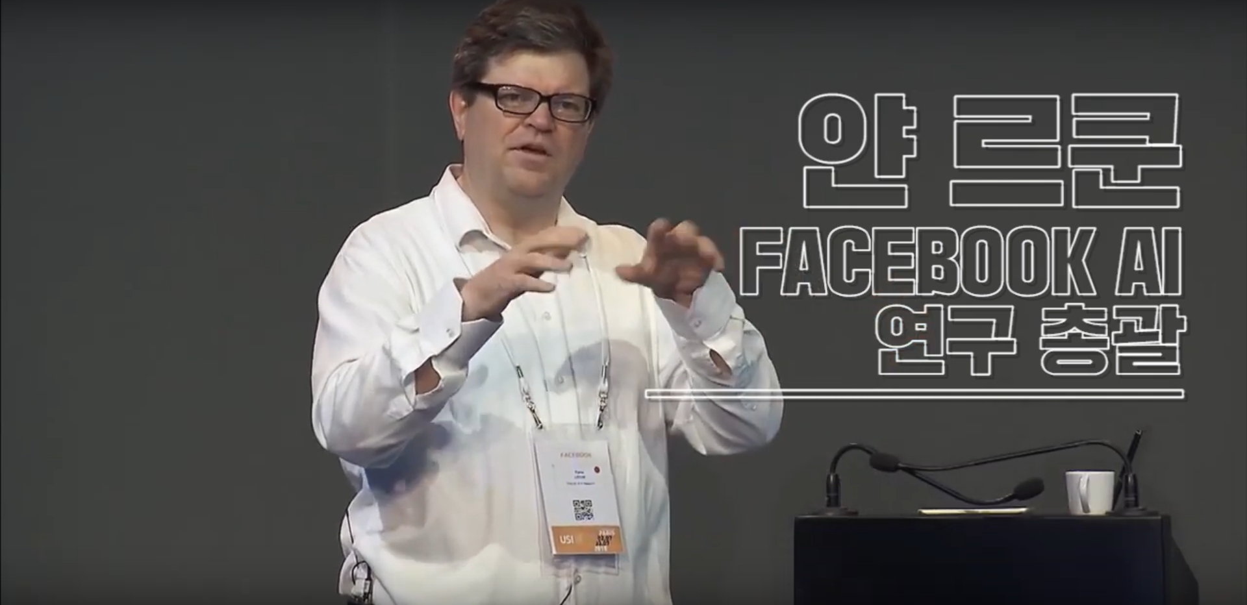

Slide 4
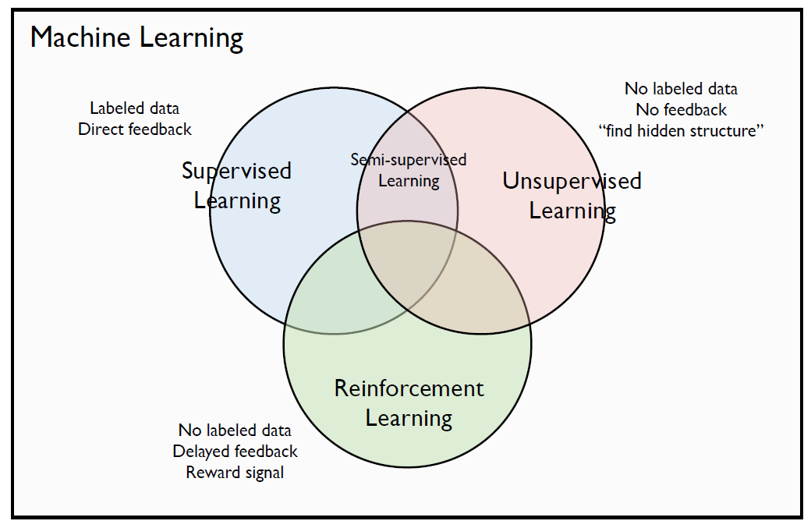
Branches of ML

Slide 5
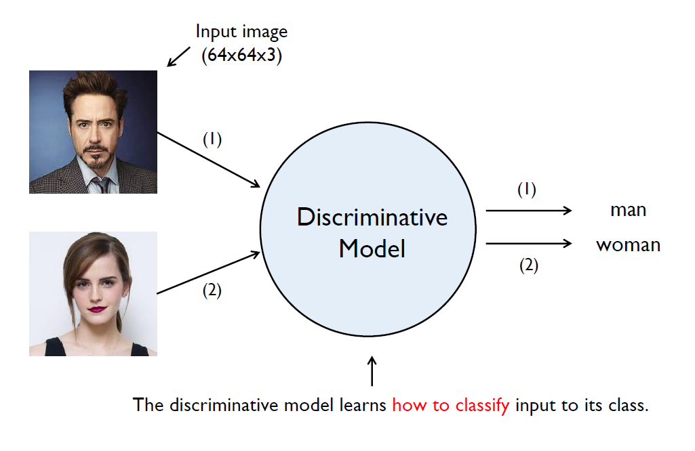
Supervised Learning

Slide 6
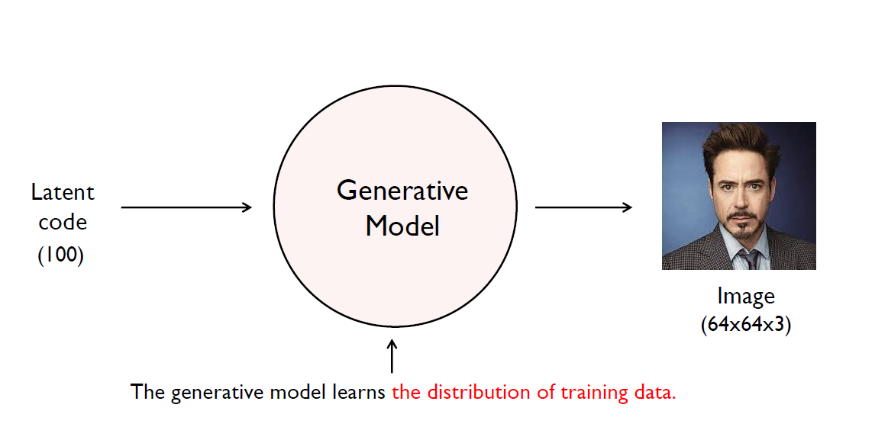
Unsupervised Learning

Slide 7
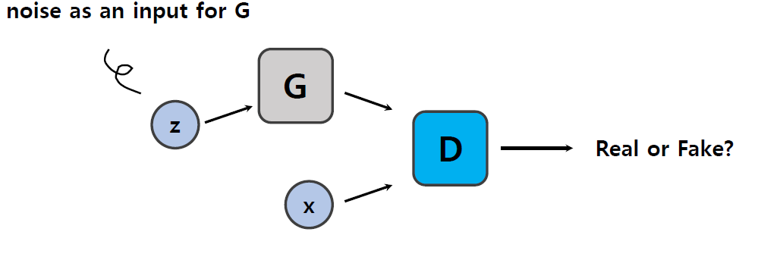
GAN

Slide 8
Probability Distribution
x : actual data.
P_{data}(x) : the distribution of actual data.
z : input noise.
P_{g}(z) : the distribution of data generated by the model(generator).
D : Discriminator
G : Generator

Slide 9
Intuition in GAN
Discriminator :
Classifies whether the image is real or fake.
The probability of that x came from the real data(0~1)
Generator :
Create an fake image that is indistinguishable from real to deceive the discriminator.

Slide 10
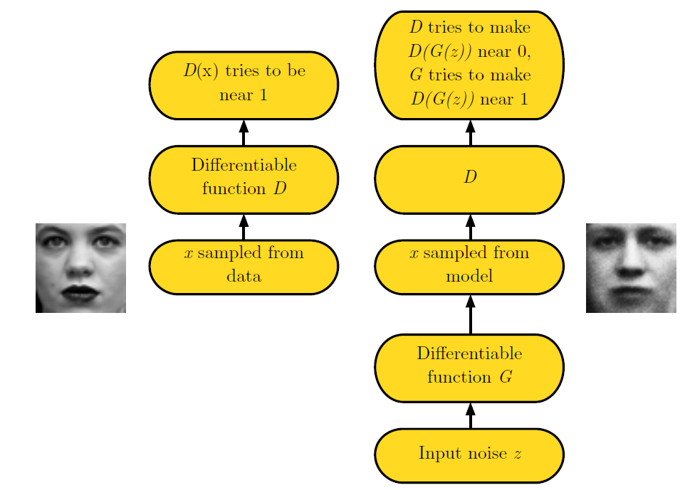
Adversarial Nets Framework

Slide 11
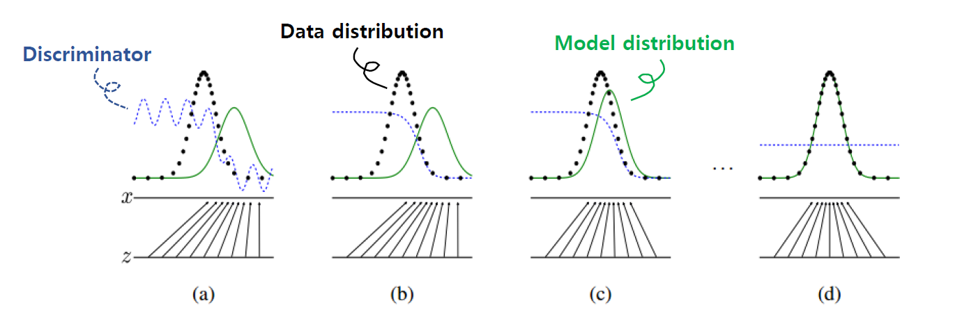
Schmetaic Overview

Slide 12
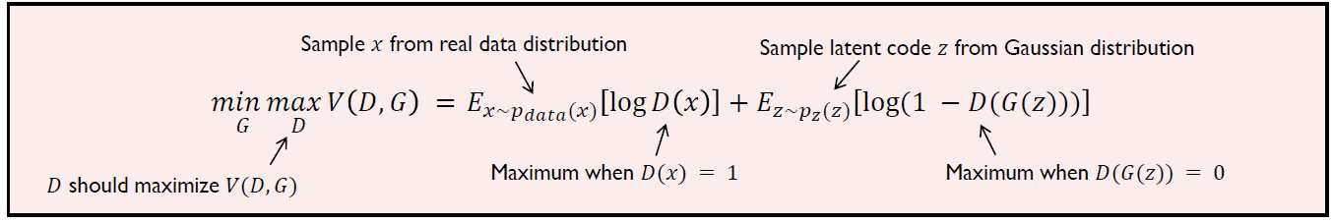
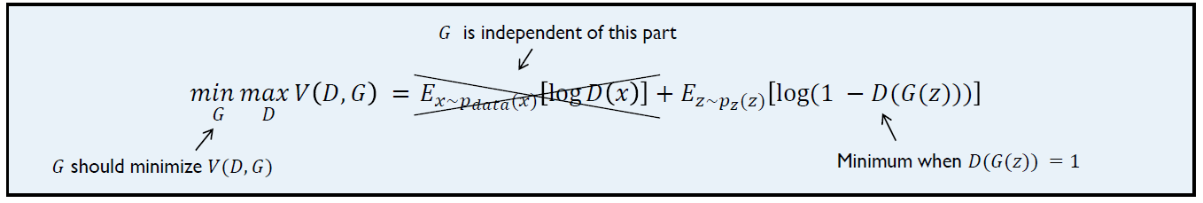
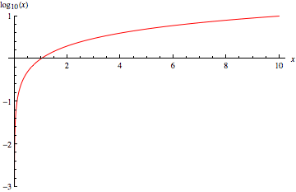
Objective Function of GAN
Minimax Game

Slide 13
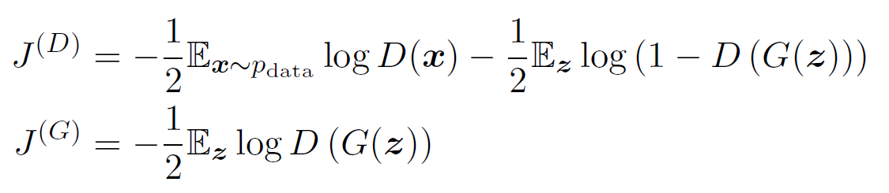
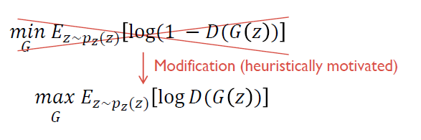
Non-Saturating Game
http://incredible.ai/artificial-intelligence/2017/04/15/GAN/
Notes:
Minimax를 실제 적용하면 이론처럼 잘 돌아가지 않습니다. Discriminator는 cross entropy를 minimize시키고, Generator는 동시에 maximize시키려고 합니다. 처음에는 Discriminator가 실수를 많이 하기 때문에 loss값이 크게 나오며 이는 gradient도 커지게 되며 학습이 빠르게 일어납니다. 문제는 학습하면서 discriminator가 거의 완벽하게 잡아낼때쯤에는 loss값이 0으로 saturate되며, generator의 gradient값은 vanish가 되버립니다.

Slide 14
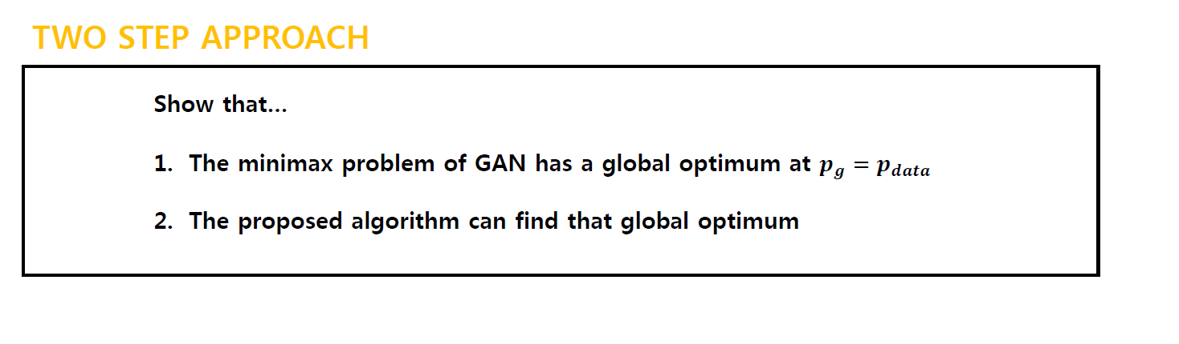
Theoretical Results
https://srome.github.io/An-Annotated-Proof-of-Generative-Adversarial-Networks-with-Implementation-Notes/
Notes:
http://jaejunyoo.blogspot.com/2017/01/generative-adversarial-nets-2.html

Slide 15
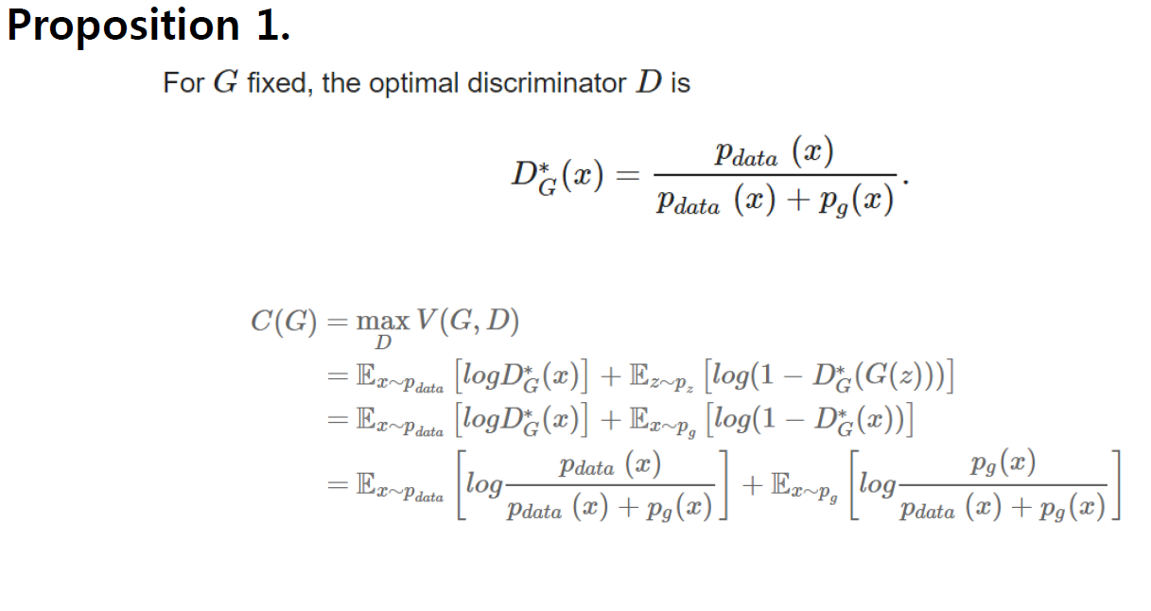
Theoretical Results

Slide 16
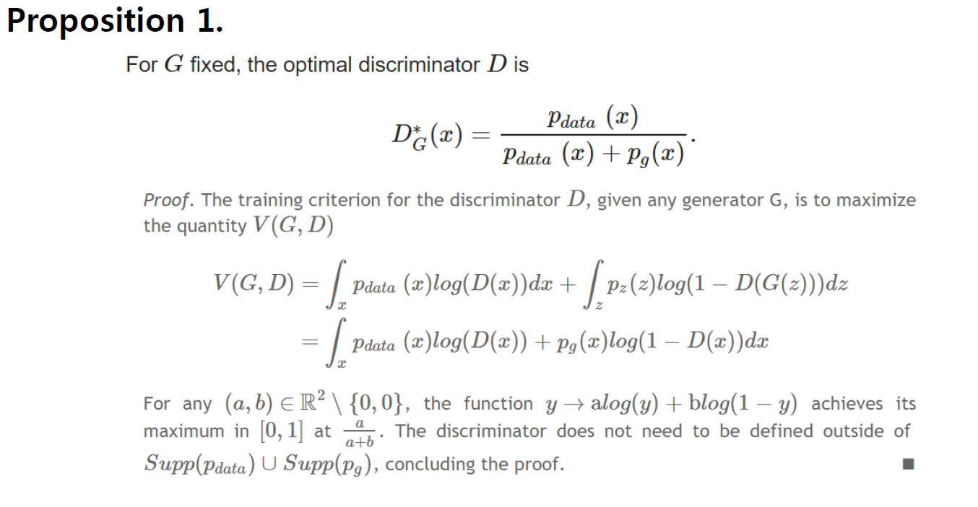
Theoretical Results

Slide 17
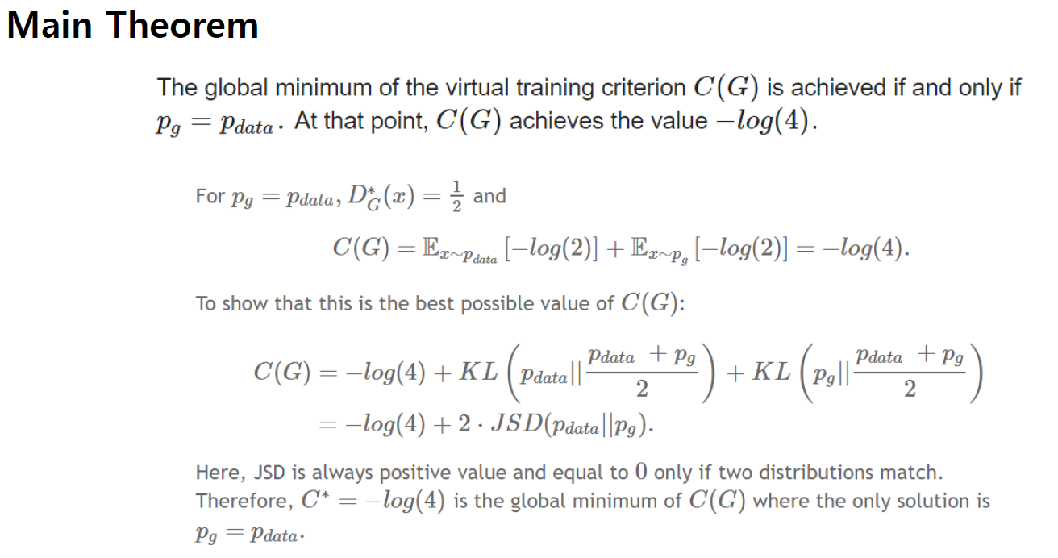
Theoretical Results

Slide 18
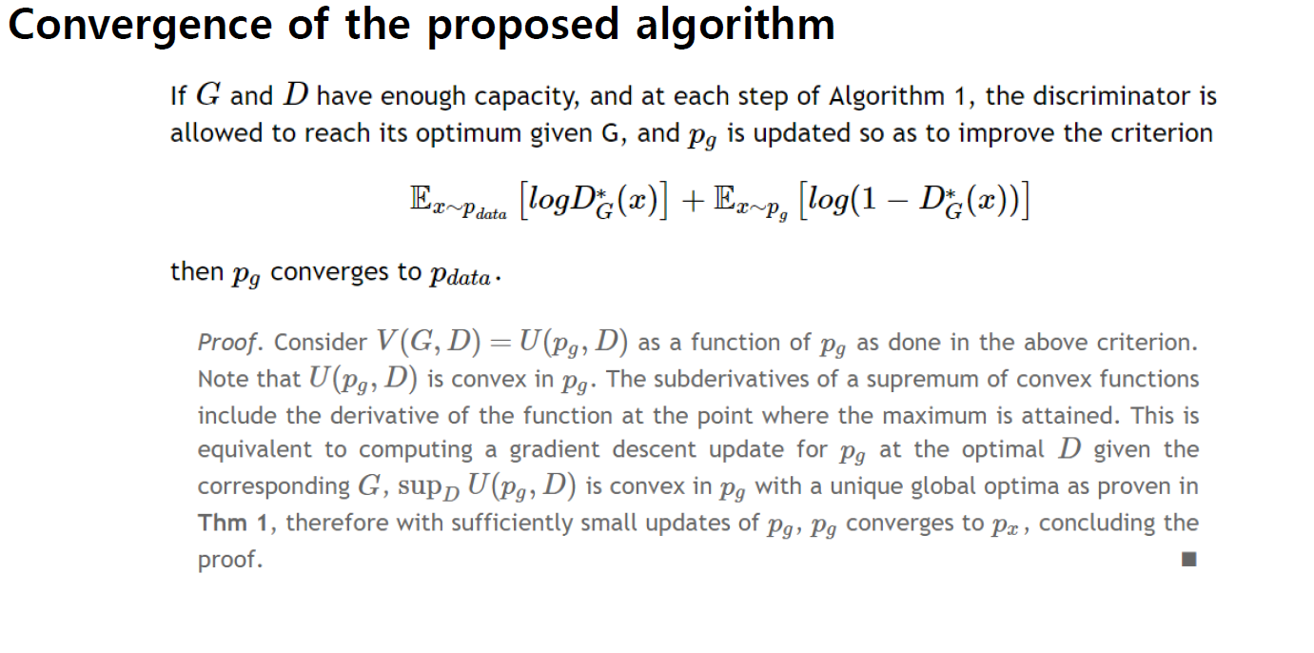
Theoretical Results

Slide 19
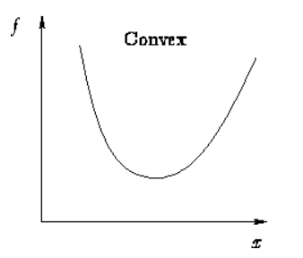
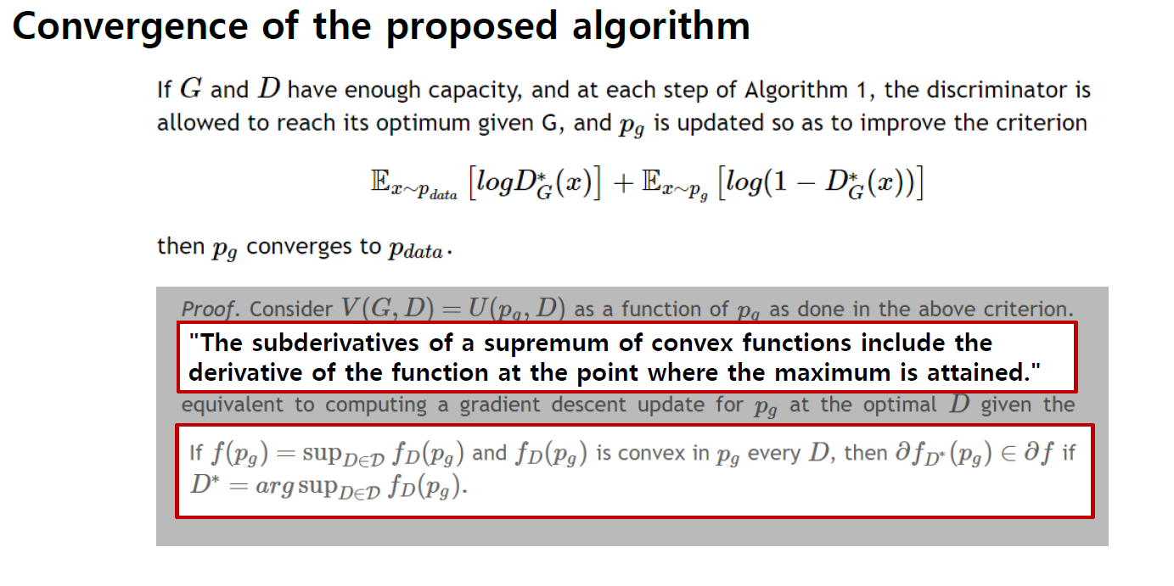
Theoretical Results
http://jaejunyoo.blogspot.com/2017/01/generative-adversarial-nets-2.html

Slide 20
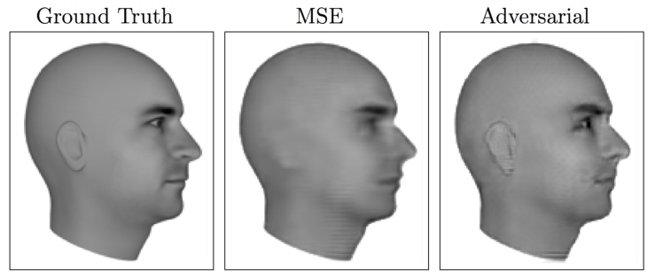
Advantages & Disadvantages
Advantages

Slide 21
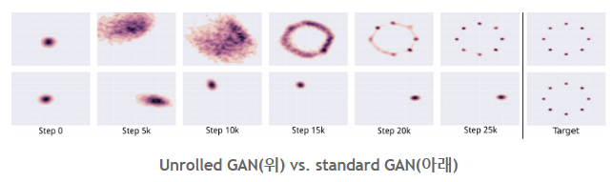
Disadvantages
Mode Collapse
Notes:
하나의 mode에만 weight를 준다

Slide 22
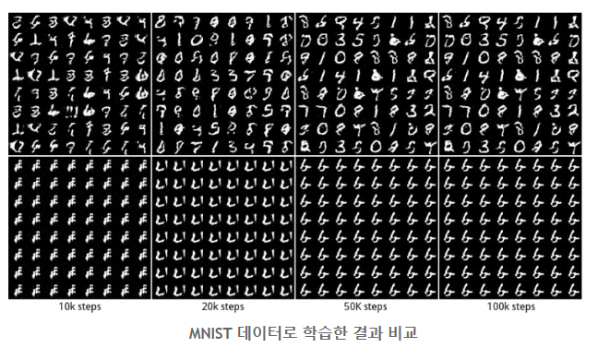
Mode Collapse
http://jaejunyoo.blogspot.com/2017/02/unrolled-generative-adversarial-network-1.html

Slide 23
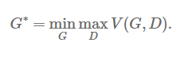
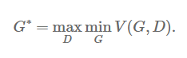
Mode Collapse 생기는 이유!
Generator와 Discriminator에 대한 gradient descent를 번갈아 가며 하기 때문에 neural network에서 minimax problem인지 maximin problem인지 구분을 못한다.

Slide 24
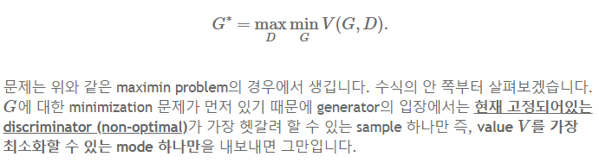
Mode Collapse

Slide 25
PyTorch Implementation
https://github.com/yunjey/pytorch-tutorial/blob/master/tutorials/03-advanced/generative_adversarial_network/main.py

Slide 26
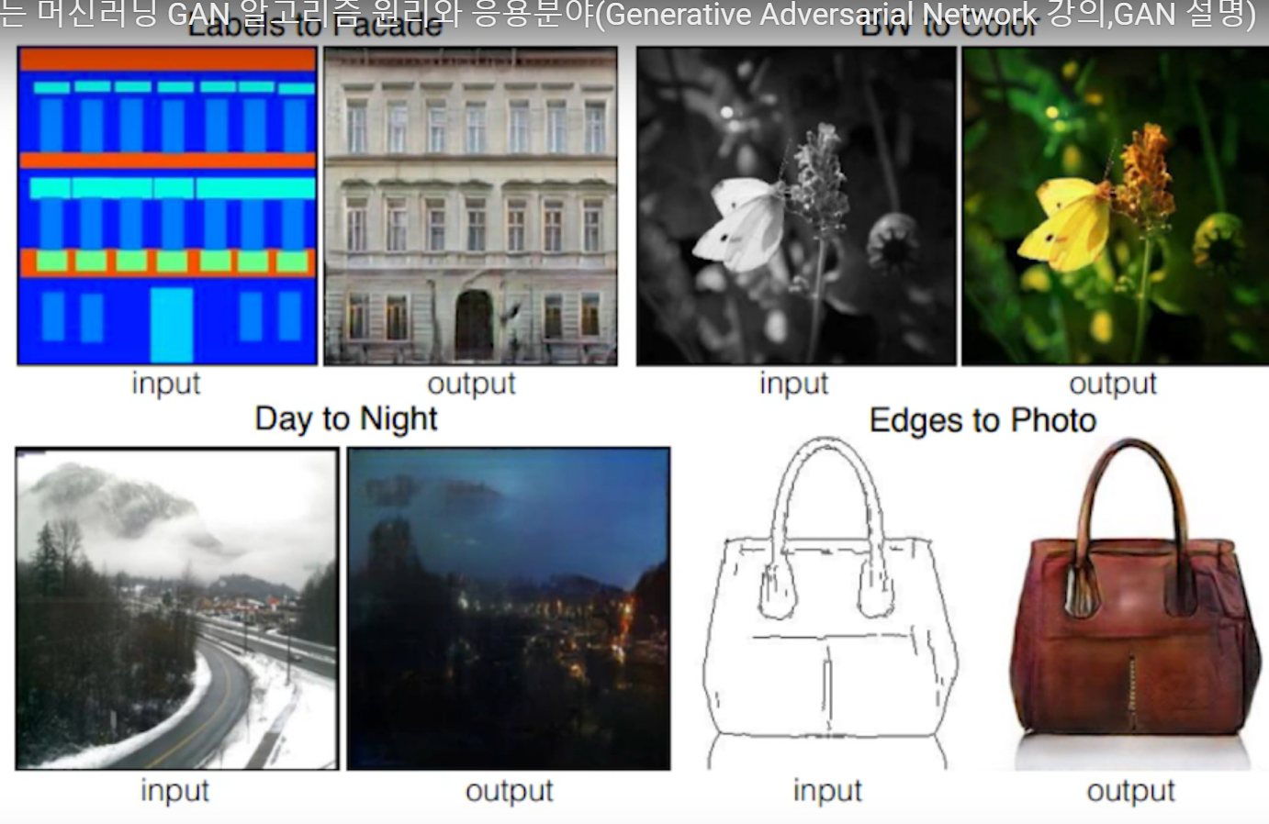
Pix2Pix
Notes:
https://www.youtube.com/watch?v=N9ewzLUZhL8

Slide 27
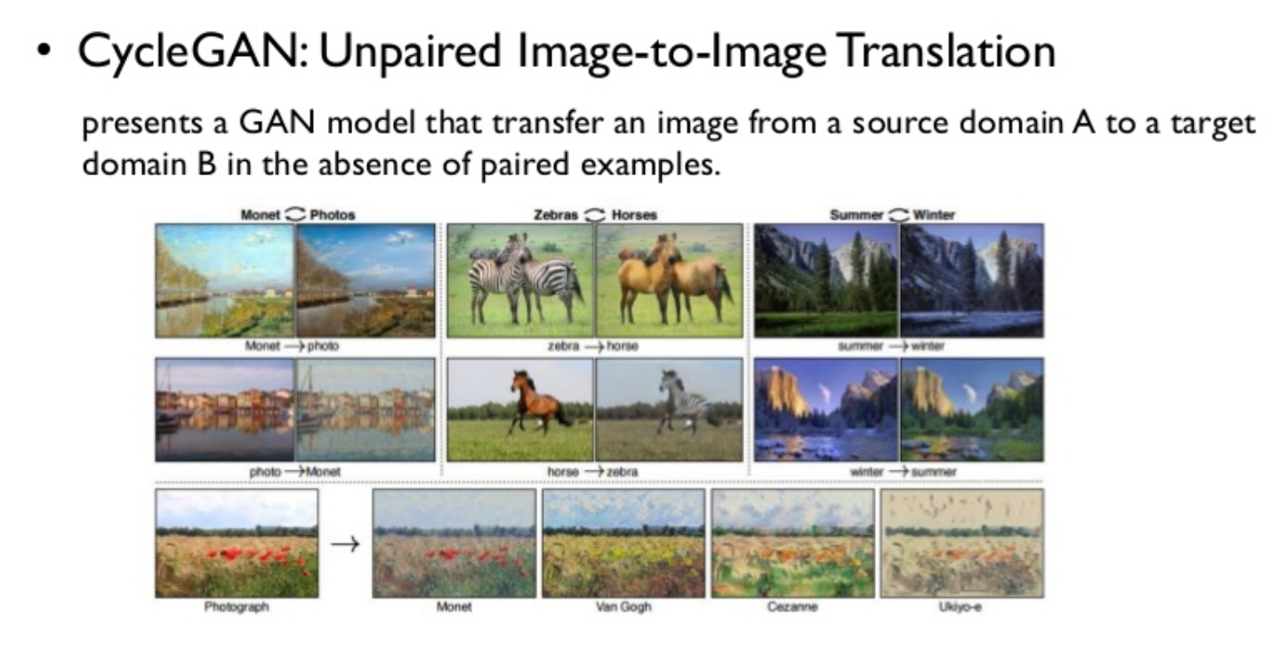
CycleGAN
Notes:
https://www.youtube.com/watch?v=odpjk7_tGY0

Slide 28
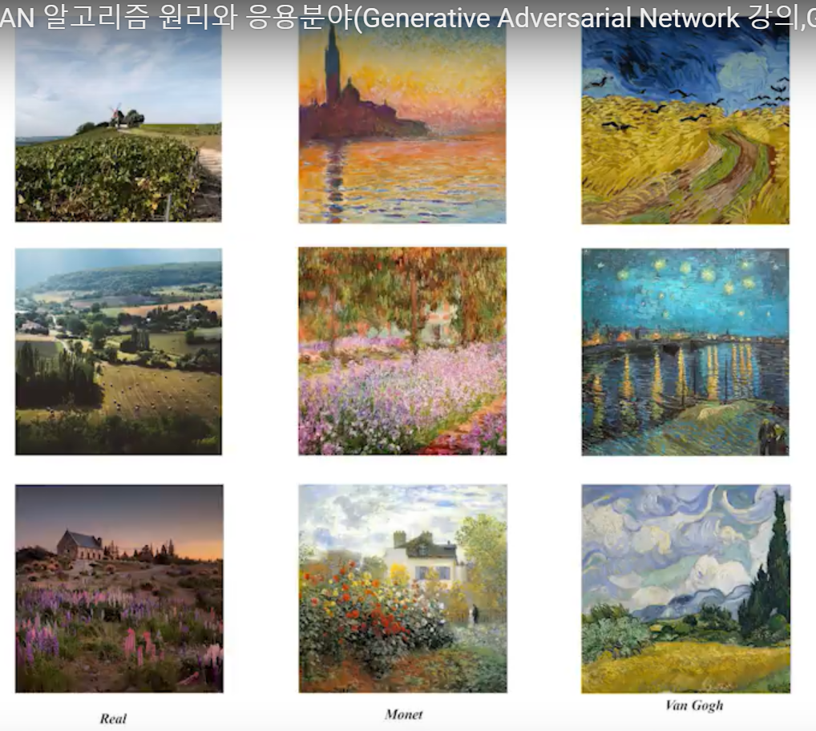
CycleGAN

Slide 29
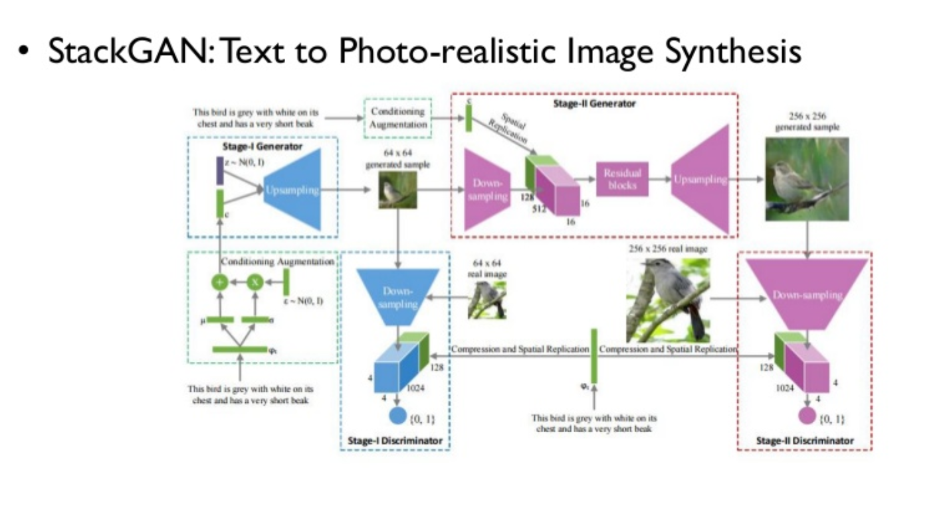
StackGAN

Slide 30
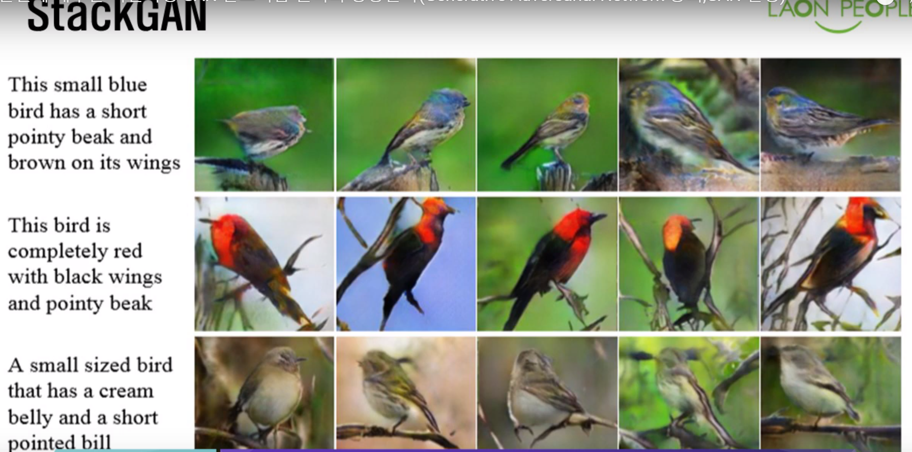
StackGAN

Slide 31
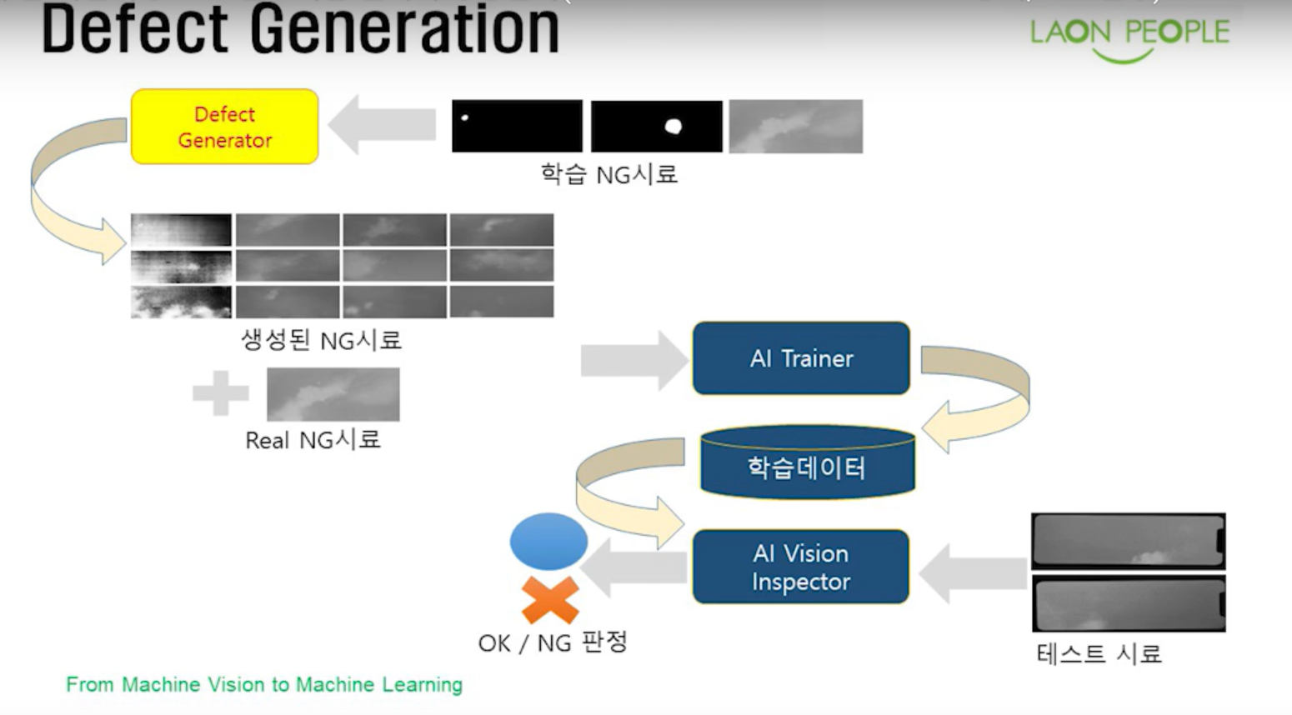
Defect Generation

Slide 32
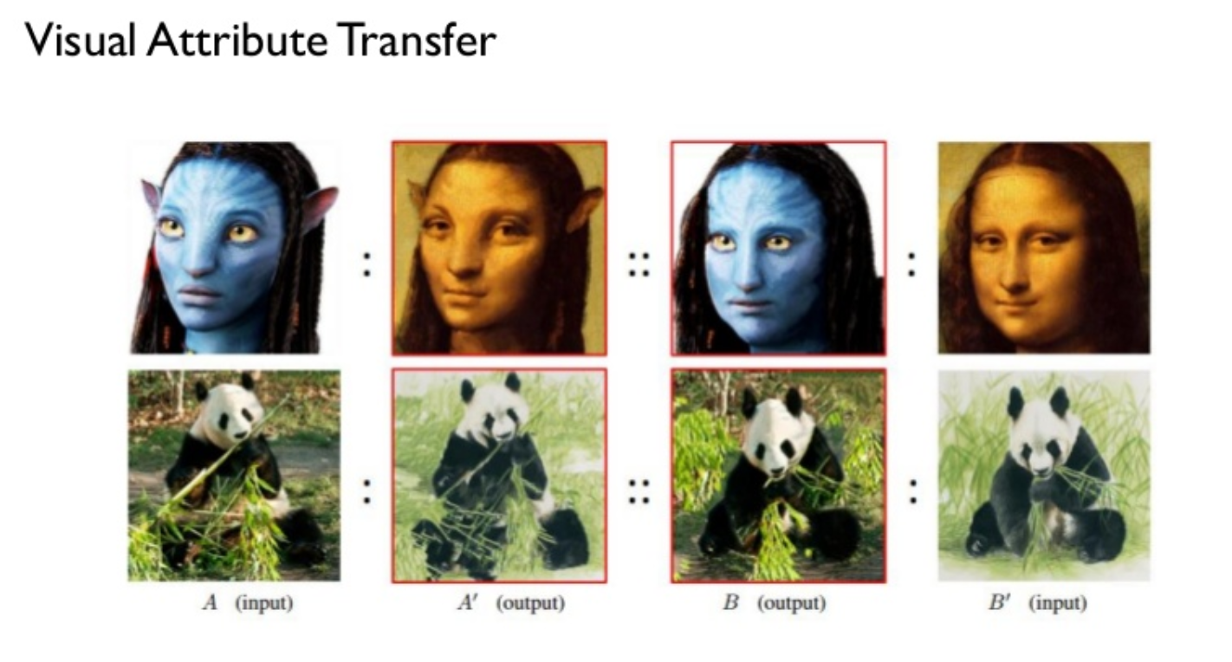
Latest Work

Slide 33
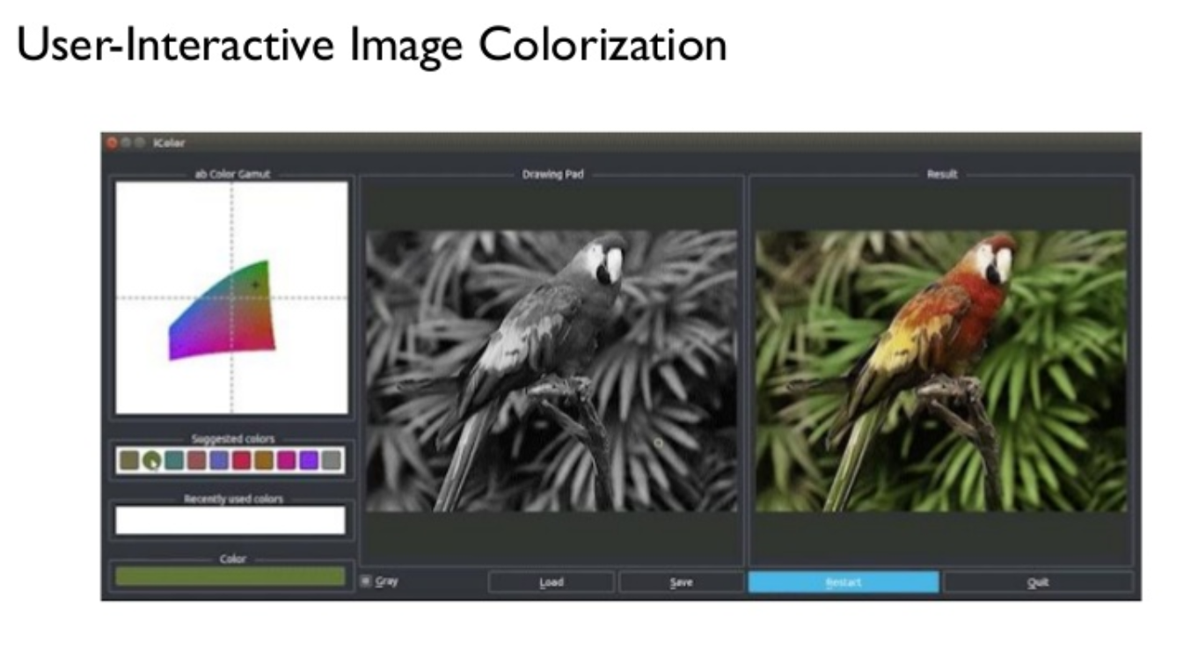
Latest Work

Slide 34
Thank you

